Slide 1
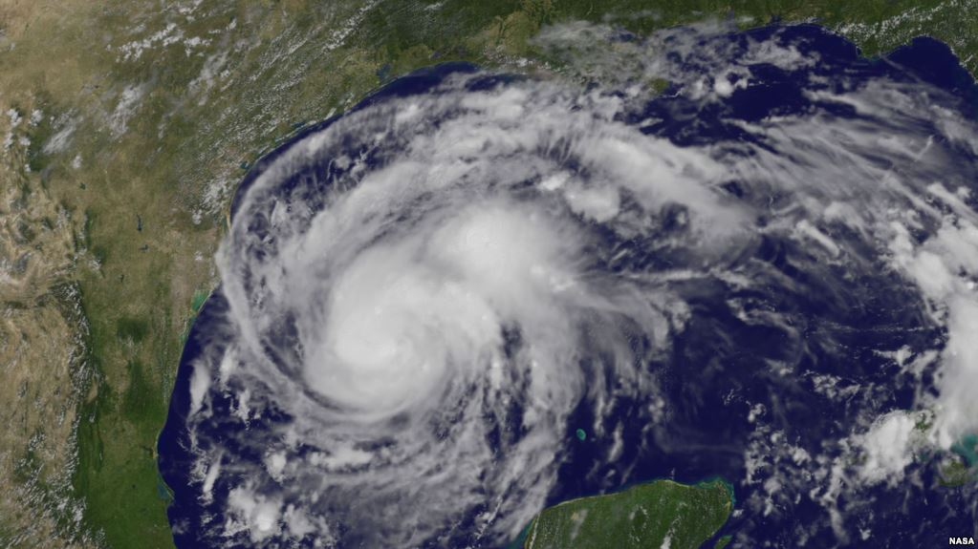
Hurricanes

Slide 2
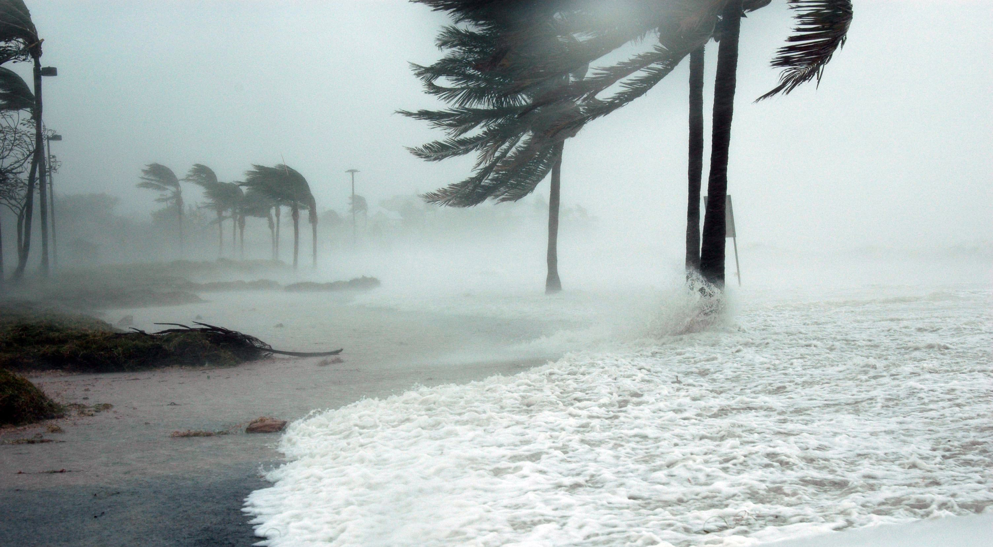
One of natures most powerful forces!

Slide 3
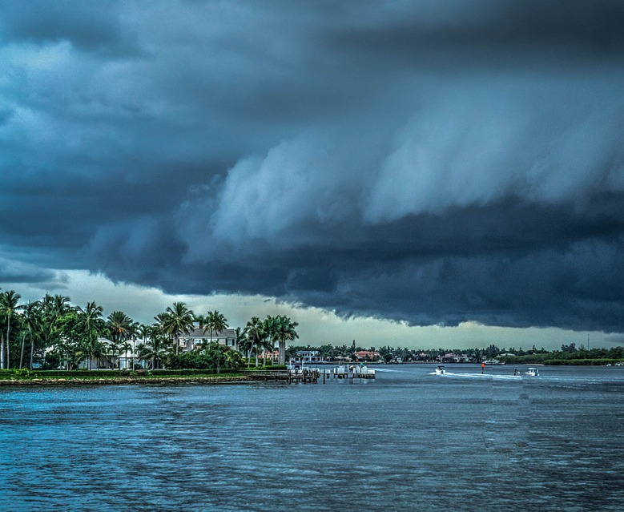
What is a Hurricane?
A hurricane is a huge rotating storm with powerful winds and heavy rain that form over warm waters.

Slide 4
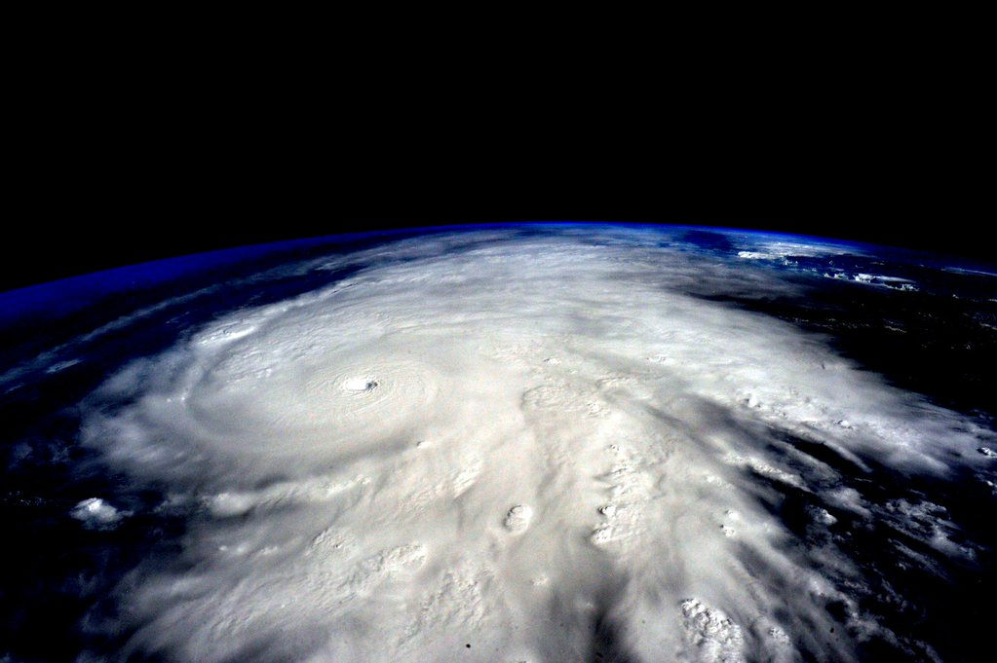
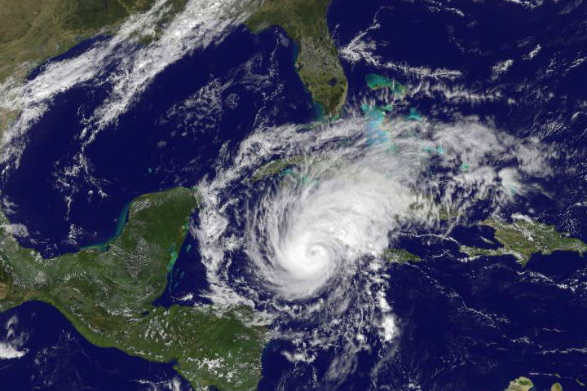
Different Names for Hurricanes
Scientific Name: Tropical Cyclone
North American and Caribbean’s: Hurricanes
Indian Ocean: Cyclones
Southeast Asia: Typhoons

Slide 5
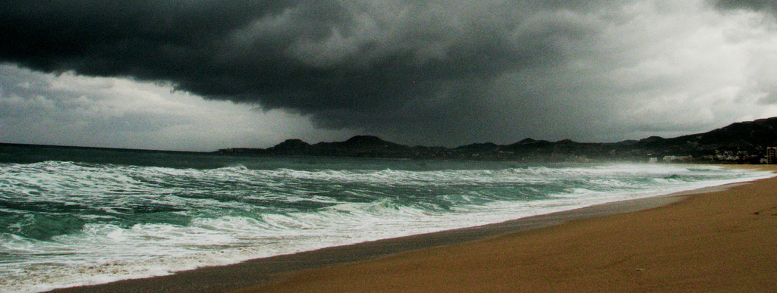
How Hurricanes Form:
Hurricanes only form over really warm ocean water of 80° F or warmer. When warm moist air over the water rises, it is replaced by cooler air. The cooler air will then warm and start to rise which causes huge storm clouds to form as the cycle continues. The clouds then rotate with the spin of the earth. If there is enough warm water to feed the storm, a hurricane forms!

Slide 6
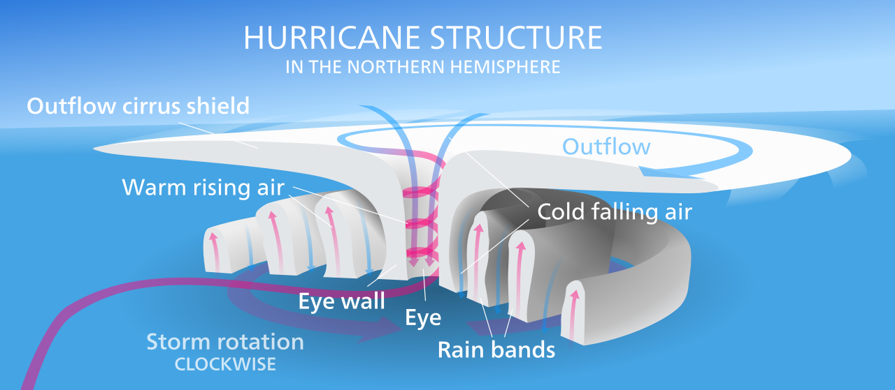
Parts of a Hurricane

Slide 7
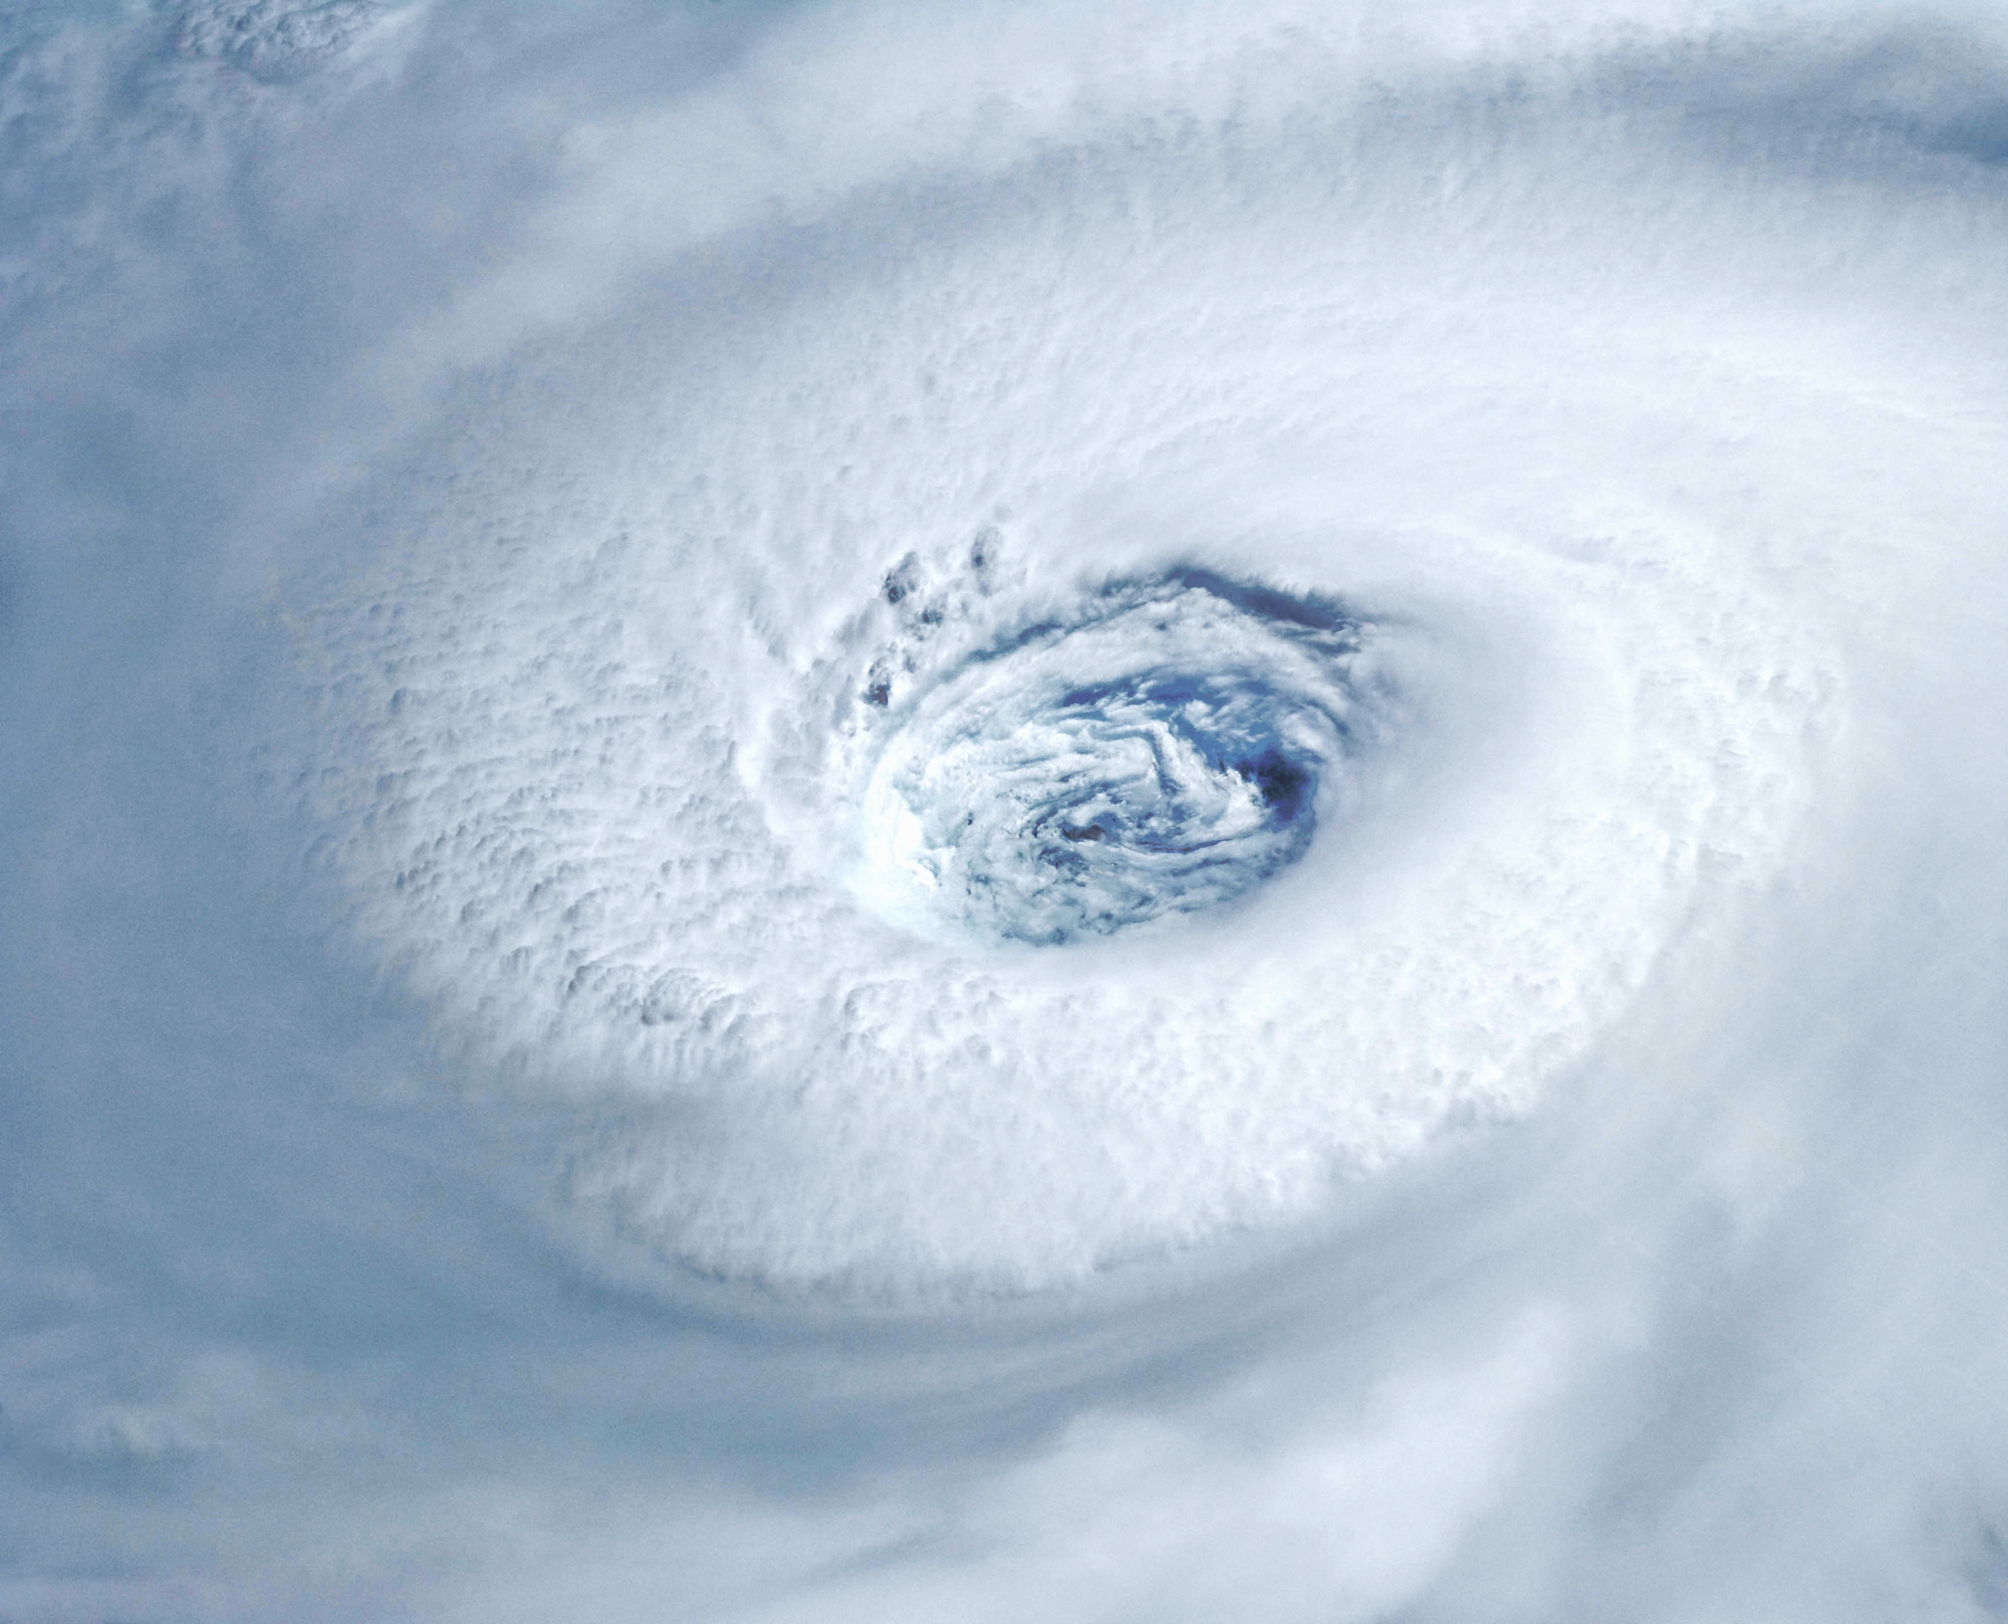
The Eye
Hurricanes rotate around a circular center called the eye. The eye is where it is calm with no clouds.

Slide 8
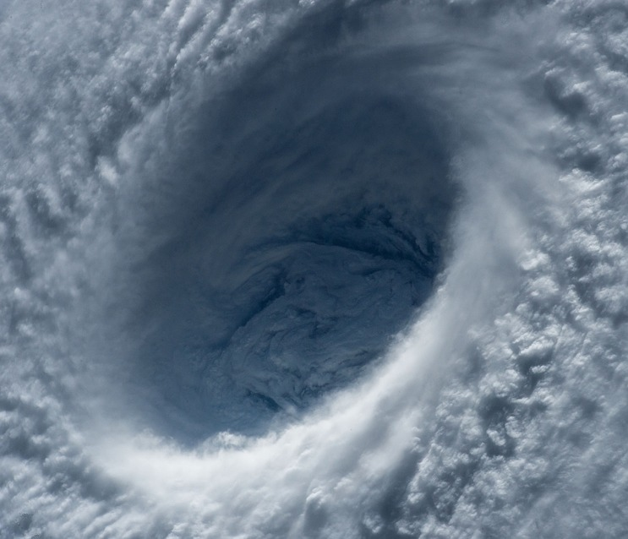
The Eye Wall
Surrounding the eye is the eye wall where it is the most dangerous part of the hurricane with the strongest wind, thickest clouds, and heaviest rain.

Slide 9
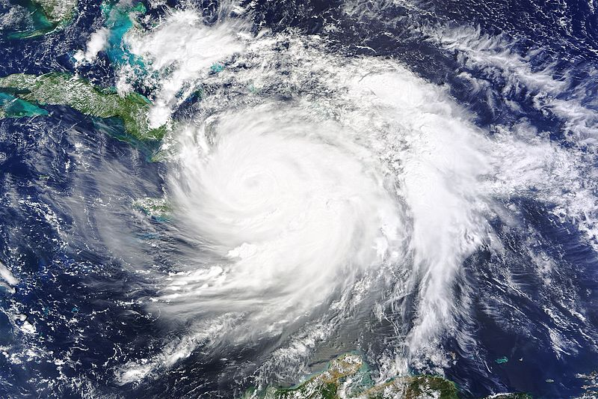
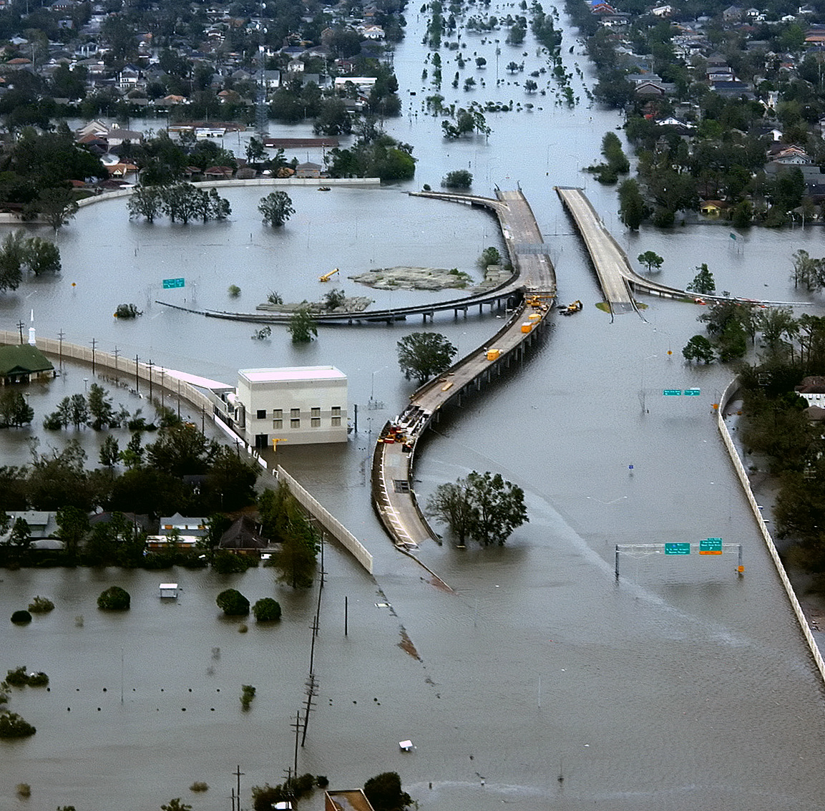
Rainbands
Rainbands can drop a huge amount of rainfall causing flooding when it hits land.

Slide 10
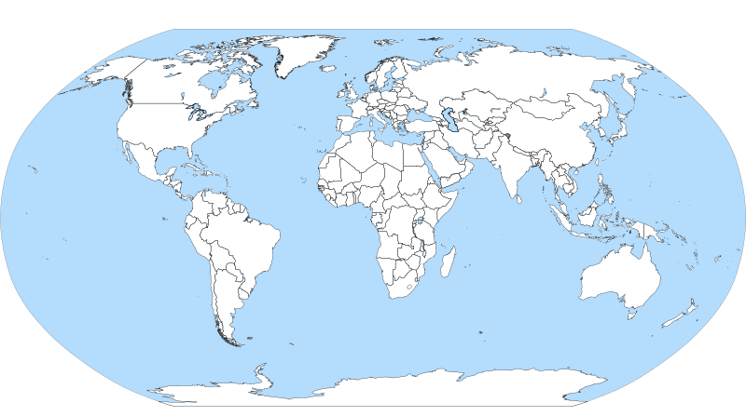
Where do Hurricanes Occur?
Hurricanes occur over the ocean in areas near the equator. There are seven major areas in the world that produce hurricanes.

Slide 11
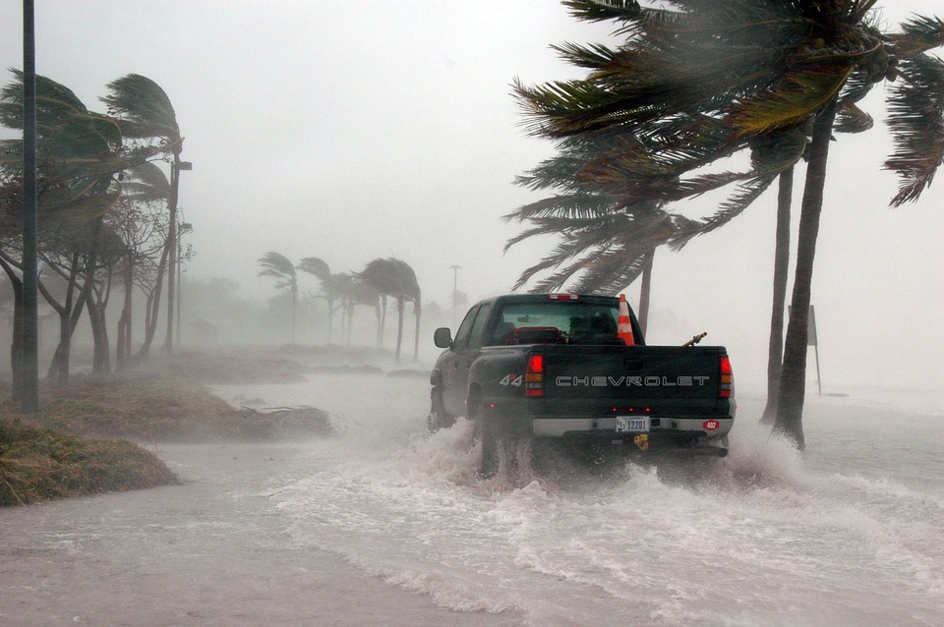
Hurricane Season
Hurricanes that form in the Caribbean and the Atlantic ocean occur between June 1st and November 30th every year.

Slide 12
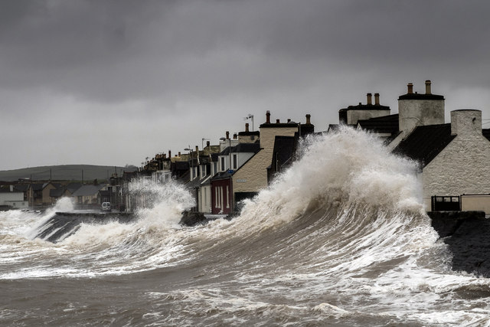
Storm Surge
When the ocean level rises at the coastline because of the strong storm, it is called a storm surge. The water piles up, unable to escape anywhere but on land which becomes devastating because it causes major flooding.

Slide 13
Categories
Hurricanes are categorized according to the speed of sustained winds. It is a Tropical Storm when the wind speed is 39 – 73 mph. Over 73 and it will be upgraded to a hurricane!
Category 1:
74 to 95 mph
Category 2:
96 to 110 mph
Category 3:
111 to 129 mph
Category 4:
130 to 156 mph
Category 5:
157 or higher mph

